Slide 1
Embedded Systems Term Project
Simple IoT Application
Presented by:
Kirollos N. Sorour 900153483

Slide 2
AGENDA
Project Proposal
System Description
Block Diagrams and Schematic
Programming Milestones
Future Considerations

Slide 3
Project Proposal
Objective: To develop a time-aware, embedded smart solution to keep some loads (LEDs) connected to the Internet.
I will do so using an RTC and a Wi-Fi module which will take commands from an authorized online user and direct these commands to the microcontroller.

Slide 4
System Description - The Hardware Package
A STM32L432KC microcontroller
A DS3231 RTC module
An Adafruit Feather HUZZAH ESP8266 Wi-Fi module
A Usb to Serial/TTL Adapter

Slide 5
System Description - The Software Package
Source code running on the microcontroller:
Collecting Time and Temperature data from the RTC using I2C
Listening to commands coming from the Wi-Fi module through UART
Source code running on the Wi-Fi module:
Specifying the HTML Server details and how to interact with clients.

Slide 6
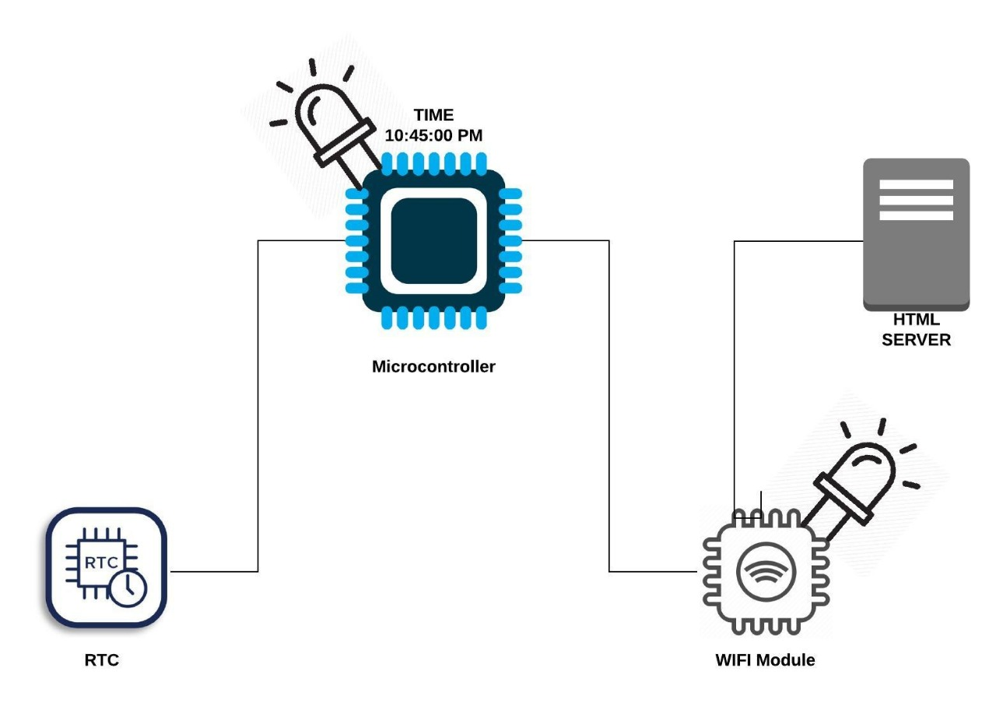
Block Diagrams and Schematic

Slide 7
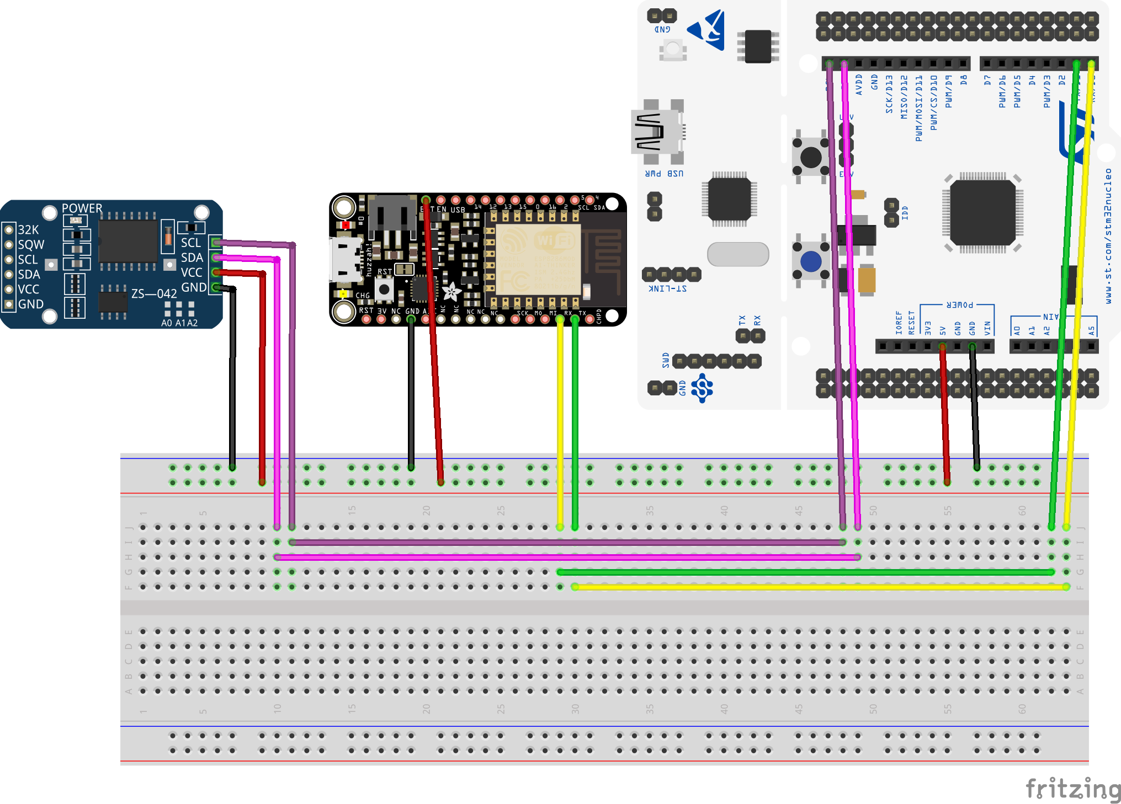

Slide 8
Programming Milestones - 1
Milestone 1: Reading from RTC using I2C:
Simplest Milestone: “Done”
Relevant Code Lines used:
HAL_I2C_IsDeviceReady(&hi2c1, 0xD0, 10, HAL_MAX_DELAY)
HAL_I2C_Master_Transmit(&hi2c1, 0xD0, secbuffer, 1, 10);
HAL_I2C_Master_Receive(&hi2c1, 0xD1, secbuffer+1, 1, 10);

Slide 9
Programming Milestones - 2
Milestone 2: Developing a basic HTML Server using the Wi-Fi module
Challenging Milestone: “Done”
Relevant Code Lines used:
client.println("HTTP/1.1 200 OK");
if (header.indexOf("GET /ESP/on") >= 0)
"<p><a href=\"/RTC\"><button class=\"button\">DISPLAY</button></a></p>"

Slide 10
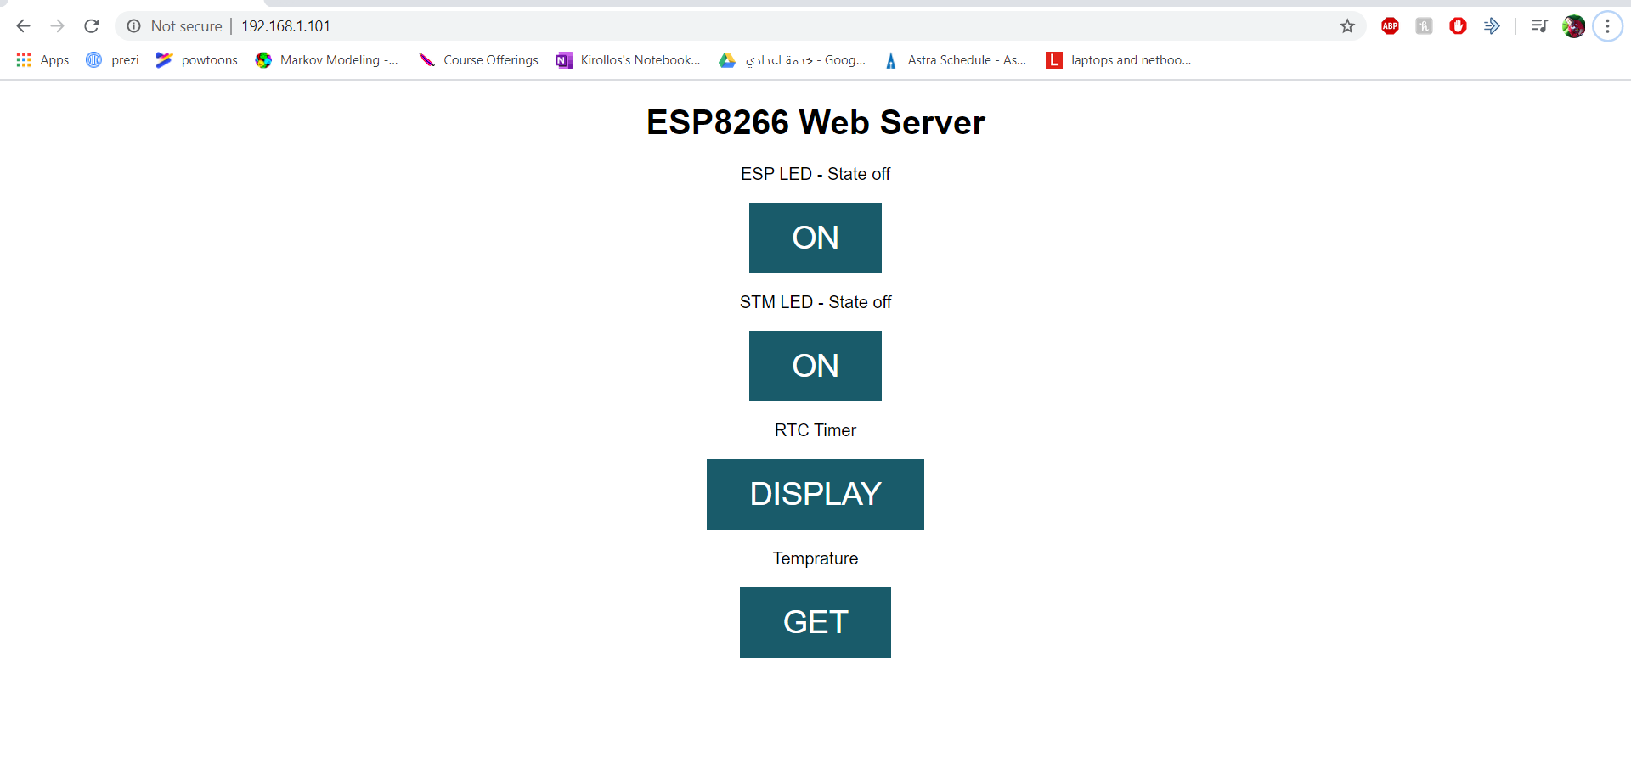
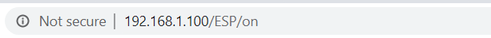
Milestone 2 Relevant Screenshots

Slide 11
Programming Milestones - 3
Milestone 3: Interfacing microcontroller with Wi-Fi Module using UART
Communication scheme and commands Design
Integration Milestone: “Done”

Slide 12
Milestone 3 Command Table
Command | Char count | Sender | Receiver | Functionality
“!” | 1 | STM32 | ESP8266 | Retrieve IP
“T_ON” | 4 | ESP8266 | STM32 | Turn LED on
“T_OF” | 4 | ESP8266 | STM32 | Turn LED off
“TIME” | 4 | ESP8266 | STM32 | Display Time
“TEMP” | 4 | ESP8266 | STM32 | Display Temperature

Slide 13
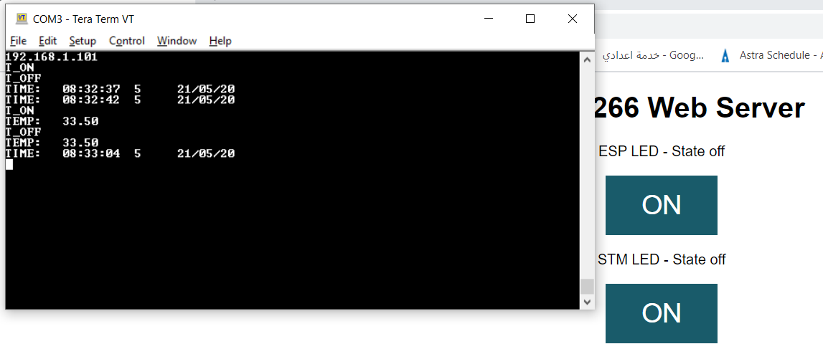
Milestone 3 Final Output

Slide 14
Future Considerations
1- Adding an indicator screen
2- Power calculation and choosing a sufficient battery
3- Using advanced AT commands with the Wi-Fi module
4- Board PCB design and enclosure

Slide 15
Project Documentation - Github Repository
My project is uploaded to a Github repository, It currently is fully documented to a good level of detail.
The link for this public repository is:
https://github.com/KirollosNagi/IoTSimpleApp

Slide 16
References
The STM32L432KC Datasheet
The DS3231 RTC module Datasheet
The Adafruit Feather HUZZAH ESP8266 Wi-Fi module Datasheet
The Usb to Serial/TTL Adapter Datasheet

Slide 17
Thank you
Any Questions?

